Slide 1
Continuous education and validation of prior learning in Youth Work

Slide 2
Useful Learning Experiences
Intercultural exchange
Peer learning networks
Council of Europe trainings in human rights education
Peer grading – evaluation system
Quality assuarance and life-long learning

Slide 3
Points for Development
Common ground for education and professionalization of YW
Standardization of YW
Value of youth work
Life-long learning

Slide 4
Good Practices
Still a challenge to have model examples of validation of continous education – systems of education in YW not developed enough accross Europe
Examples - Finland, Estonia, Bulgaria
(not seeing themselves as such, but on the right way to serve as examples)

Slide 5
Conditions that support Good Practices
Different actors have to be involved – experts in YW, policy makers, young people, etc.
Networks of community youth workers
Structures, systems, continuous and sustainable support in needed
Adequate human and financial resources have to be secured
Examples of good practices have to identified and proved
Examples of good practices have to recognized and accredited
Institutions, associations to provide support to youth workers

Slide 6
Future Perspective:
Threats
Lack of investment in future education
Not keeping up
Generational gap – mindset
Lack of understanding of needs of young people
Speed of change
Burnout

Slide 7
Future Perspective: Possibilities
Make youth work profession more appealing
Validate experience outside traditional youth work
Change the exclusive nature of youth work in the traditional sense
Policy-makers identify new skills needed
Peer learning
Learn from young people
Values-based profession – self reflection
Suppress egos
Flexibility of educational needs of youth workers (context based)

Slide 8
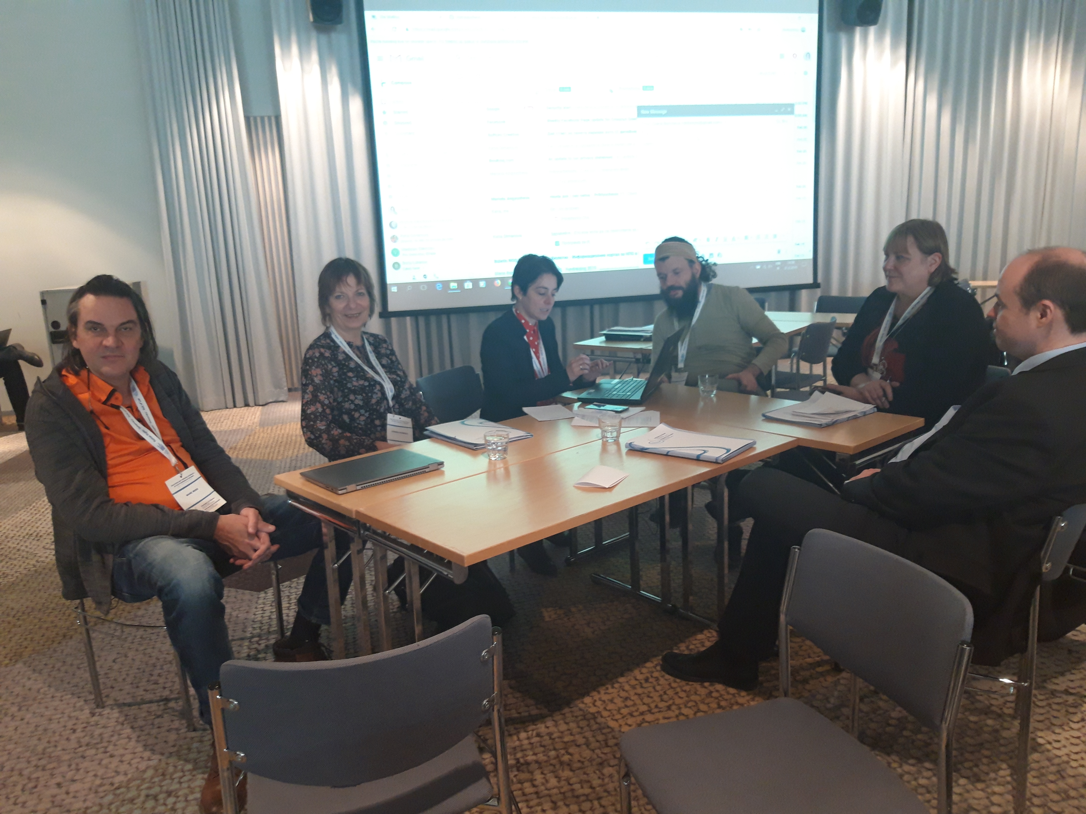
Thank you! – contact during dinner ☺

