Slide 1
Human Rights Education + Youth Work Youth Work + Human Rights Education Rui Gomes Council of Europe – Youth Department

Slide 2
Hyvää Huomenta!

Slide 3
A few questions first…
Notes:
Does your constitution recognise, guarantee, or make reference to human rights as a source of legitimacy?
YES/NO/Don’t Know
2. Are you sure?
YES/NO/Don’t Know
3. Are Human Rights part of the Council of Europe aims and mission?
YES/NO/Don’t Know
4. Are Human Rights a value of the European Union?
YES/NO/Don’t Know
5. Were/Are human rights or human rights education part of your learning path in youth work?
YES/NO/Don’t Know
6. Do you see yourself as human rights activist?
YES/NO/Only when abroad

Slide 4
www.mentimeter.com
code
880628

Slide 5
Does your constitution recognise, guarantee, or make reference to human rights as a source of legitimacy?
YES/NO/Don’t Know

Slide 6
2. Are you sure?
YES/NO/Don’t Know

Slide 7
3. Are Human Rights part of the Council of Europe aims and mission?
YES/NO/Don’t Know

Slide 8
4. Are Human Rights a fundamental value of the European Union?
YES/NO/Don’t Know

Slide 9
5. Were/Are human rights or human rights education part of your learning path in youth work?
YES/NO/Don’t Know

Slide 11
Human Rights, Democracy, Rule of Law
1949 – 47 states
Finland, 1989

Slide 12
Fundamental values
Respect for human dignity and human rights
Freedom
Democracy
Equality
Rule of law

Slide 13
Youth access to rights
a prerequisite for their
personal development and access to autonomy
an essential element of a culture of human rights, democracy and rule of law.
Committee of Ministers Recommendation (2016)7

Slide 14
The right to Human Rights Education
Education shall be directed to the full development of the human personality and to the strengthening of respect for human rights and fundamental freedoms.
Article 26.2 Universal Declaration of Human Rights

Slide 15
Youth work
Youth work makes an important contribution to active citizenship , civic engagement and social action.
Notes:
youth work makes an important contribution to active citizenship by providing opportunities to acquire the knowledge, skills and attitudes for civic engagement and social action.
Council of Europe recommendation on Youth Work (2017).

Slide 16
Youth work?...
ENABLING
EMANCIPATING
EMPOWERING
ENGAGING
ENJOYING
EDUCATION…

Slide 17
Human Rights Education….
HRE is a process whereby people learn about their rights and the rights of others, within a framework of participatory and interactive learning.
Amnesty International
Notes:
Amnesty International

Slide 18
Human Rights Education….
Knowledge, skills, attitudes and behaviour to empower learners to contribute to a universal culture of human rights in society, with a view to the promotion and protection of human rights and fundamental freedoms.
Notes:
International Year of Human Rights Learning

Slide 19
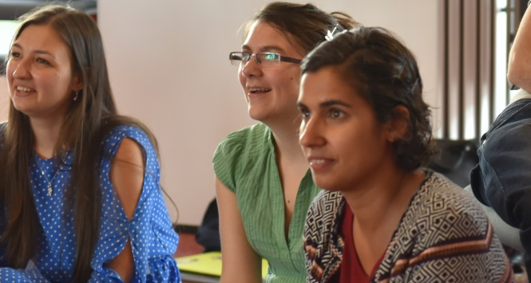
HRE involves:
Knowledge – learning about human rights
Skills for action- learning for human rights
Attitudes and values learning through and learning in human rights)

Slide 20
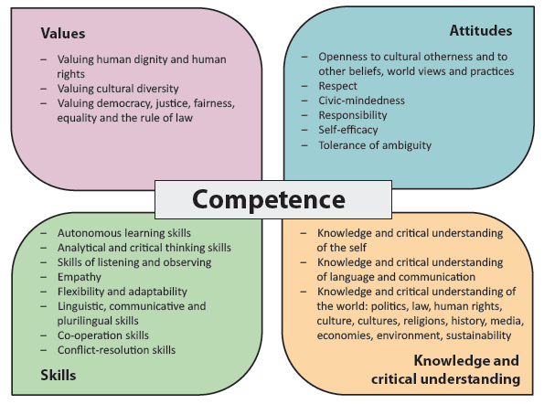
Competences for Democratic Citizenship

Slide 21
In practice there should be no distinction between HRE as a process and an outcome.

Slide 22
A duty…
Member states should include education for democratic citizenship and human rights education in the curricula for formal education at pre-primary, primary and secondary school level as well as in general and vocational education and training.

Slide 23
Tensions and dilemmas
Tensions in Human Rights Education mirror the tensions in Human Rights and our understanding of both
Notes:
We are all different, Truly all equal, too.

Slide 24
There is no human rights education without human rights. Compass, IV i, 381

Slide 25
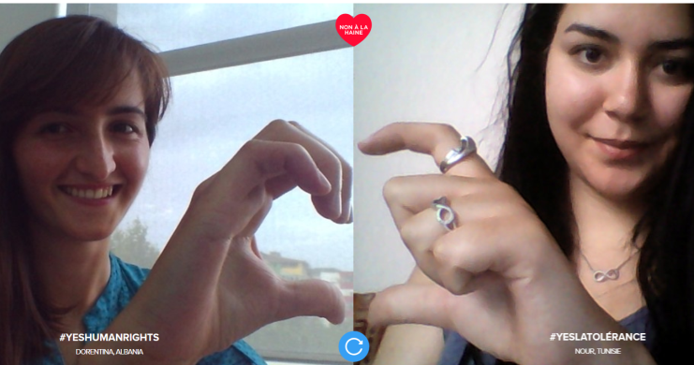
www.coe.int/compass

Slide 26
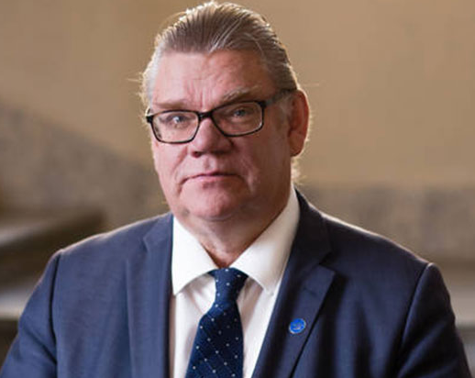
The promotion, protection and fulfilment of human rights are our collective responsibility and more necessary than ever.
TIMO SOINI
Chair of the Committee of Ministers
of the Council of Europe

